Slide 1
Chunghwa Post Job Pairing Service
Sequence diagram and UML
Group 7: Aditya Wirya Darma, Ingrid, 林玲琪, Isabella Obermeier

Slide 2


Agenda
Sequence diagram overview The bigger picture
UML overview The bigger picture
Sequence diagram detailed
Details
UML detailed
Details

Slide 3
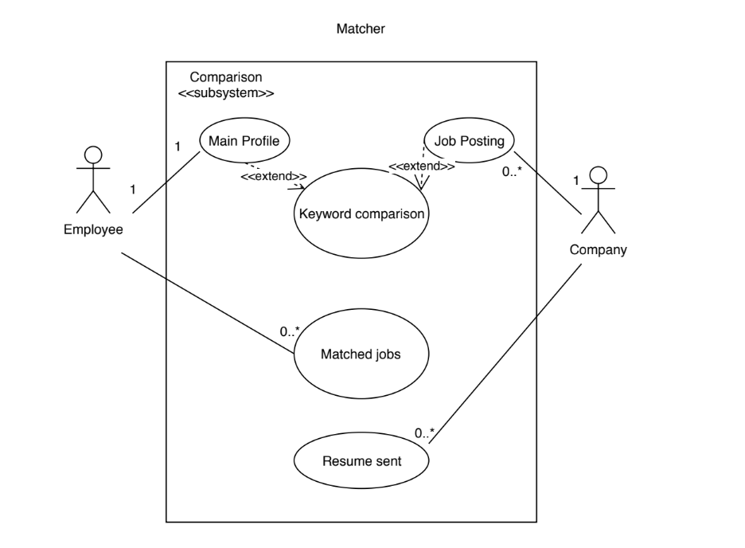
UML diagram
Overview of the matching process

Slide 4
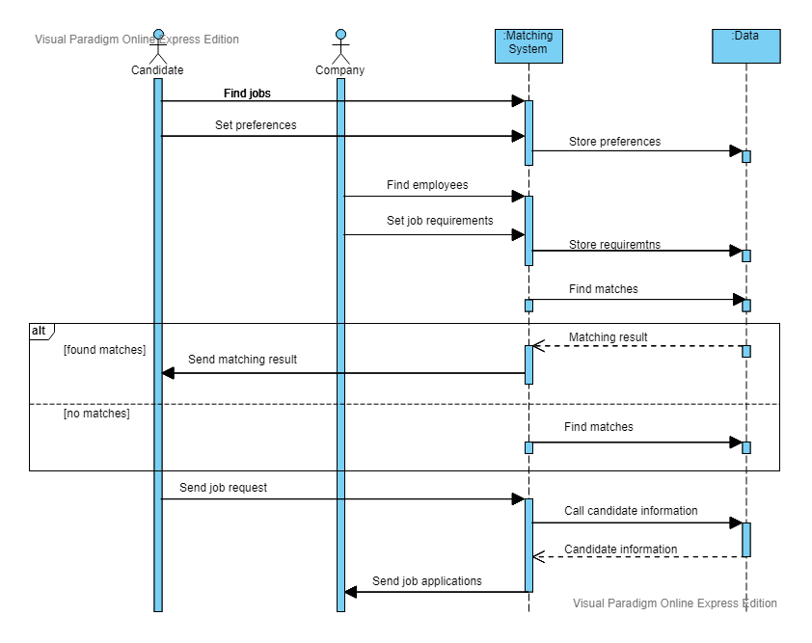
Sequence diagram
Overview of the matching process

Slide 5
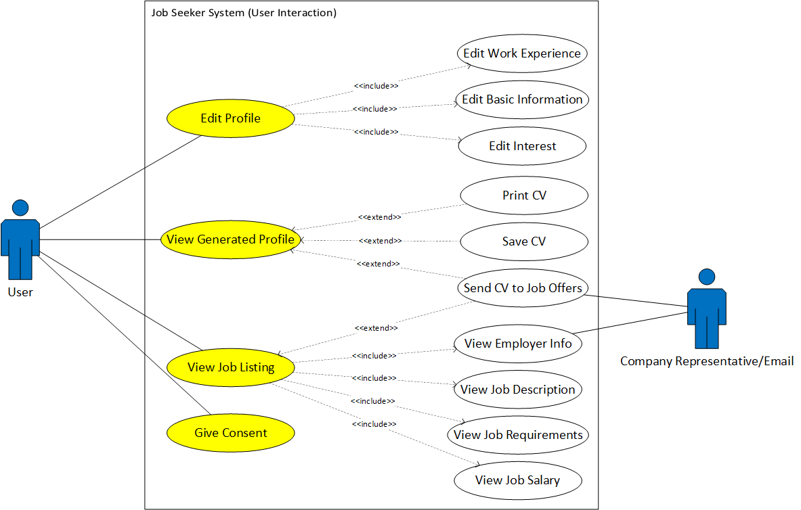
UML diagram 2
A more detailed use cases on user interaction

Slide 6
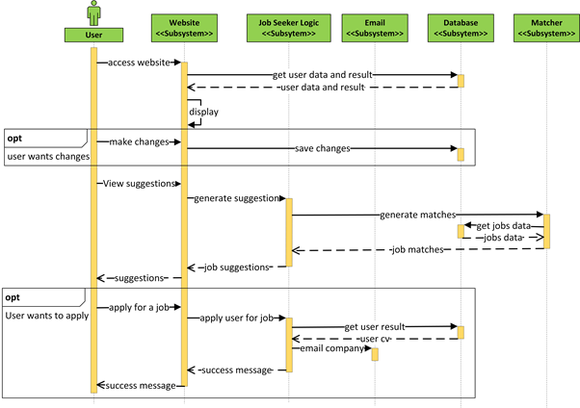
Sequence diagram 2
A more detailed process ; focusing on user interaction with the website

Slide 7
Thank you for listening!

